Slide 1
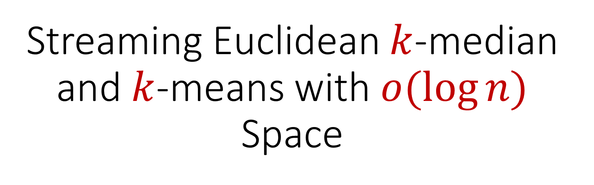
Streaming Euclidean $k$-median and $k$-means with $o(\log{n)}$ Space

Slide 2
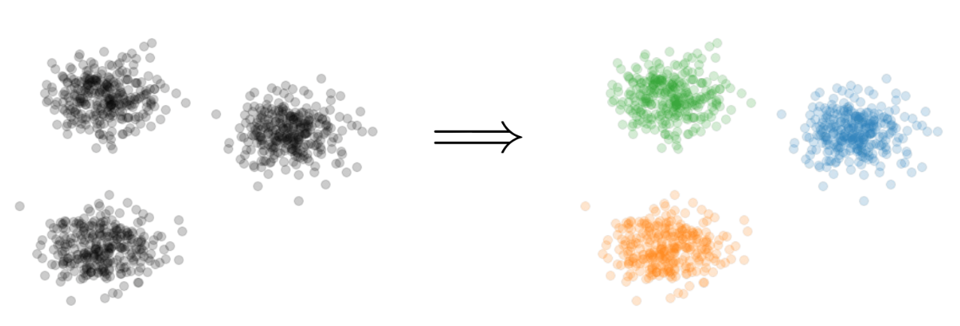

Clustering
Goal: Given input dataset $X$, partition $X$ so that “similar” points are in the same cluster and “different” points are in different clusters

Slide 3


$k$-Clustering
Goal: Given input dataset $X$, partition $X$ so that “similar” points are in the same cluster and “different” points are in different clusters
There can be at most $k$ different clusters
$$k=3$$

Slide 4
$k$-Clustering
Question: How do we measure the “quality” of each clustering?
$$k=3$$

Slide 5
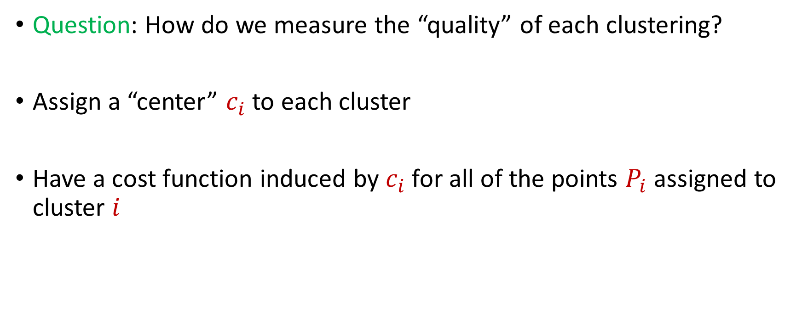
$k$-Clustering
Question: How do we measure the “quality” of each clustering?
Assign a “center” $c_{i}$ to each cluster
Have a cost function induced by $c_{i}$ for all of the points $P_{i}$ assigned to cluster $i$

Slide 6
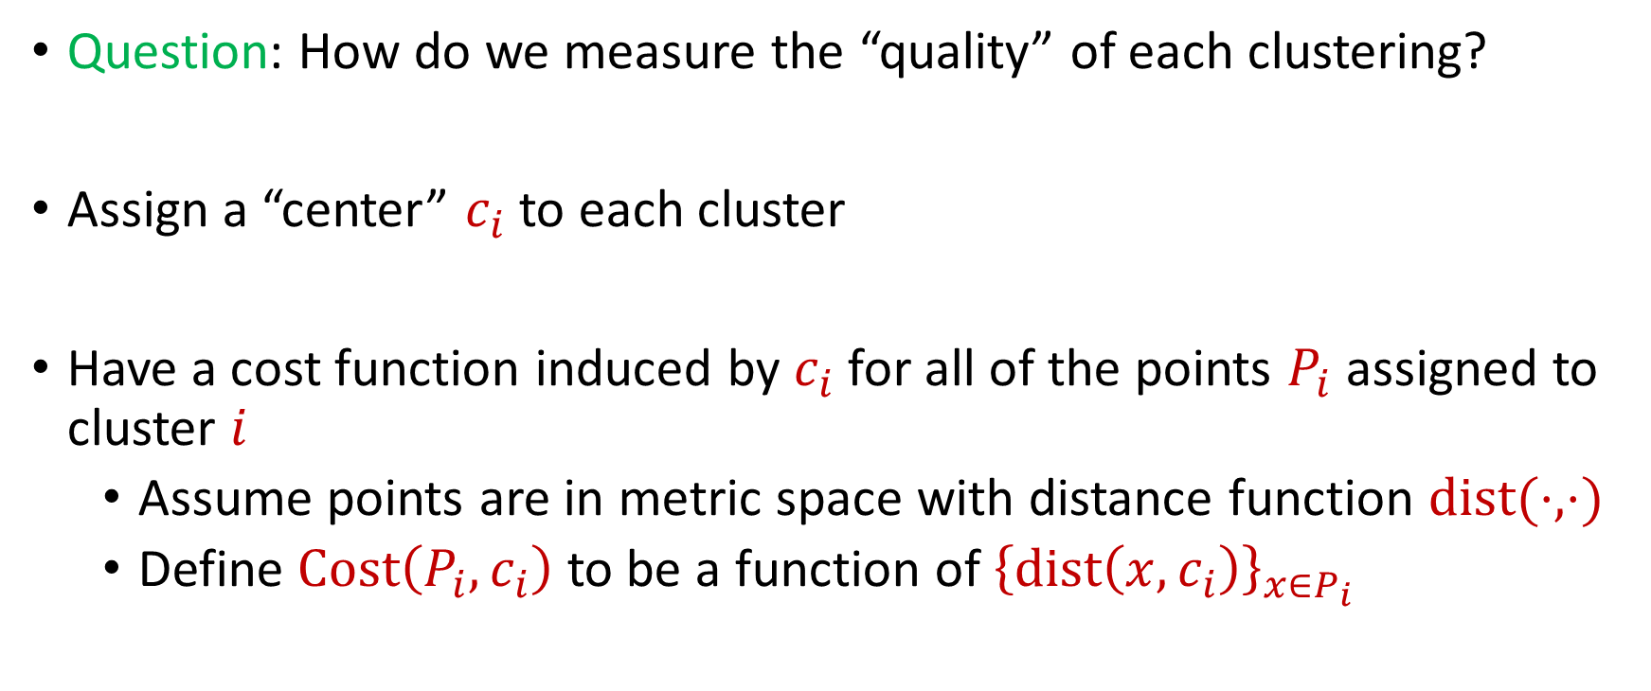
$k$-Clustering
Question: How do we measure the “quality” of each clustering?
Assign a “center” $c_{i}$ to each cluster
Have a cost function induced by $c_{i}$ for all of the points $P_{i}$ assigned to cluster $i$
Assume points are in metric space with distance function $dist(⋅,⋅)$
Define $Cost\left(P_{i},c_{i}\right)$ to be a function of ${\left\{dist\left(x,c_{i}\right)\right\}}_{x∈P_{i}}$

Slide 7
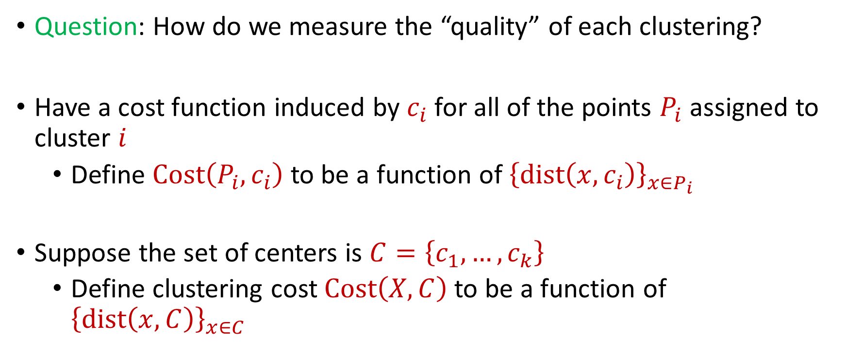
$k$-Clustering
Question: How do we measure the “quality” of each clustering?
Have a cost function induced by $c_{i}$ for all of the points $P_{i}$ assigned to cluster $i$
Define $Cost\left(P_{i},c_{i}\right)$ to be a function of ${\left\{dist\left(x,c_{i}\right)\right\}}_{x∈P_{i}}$
Suppose the set of centers is $C=\left\{c_{1},…, c_{k}\right\}$
Define clustering cost $Cost\left(X,C\right)$ to be a function of ${\left\{dist\left(x,C\right)\right\}}_{x∈C}$

Slide 8
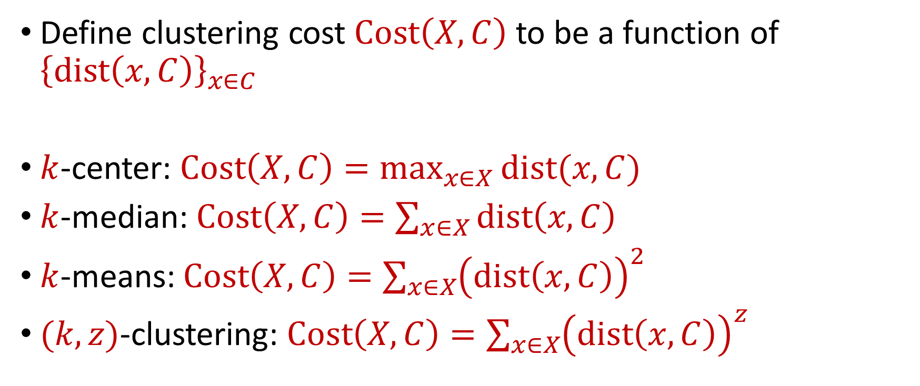
$k$-Clustering
Define clustering cost $Cost\left(X,C\right)$ to be a function of ${\left\{dist\left(x,C\right)\right\}}_{x∈C}$
$k$-center: $Cost\left(X,C\right)=\max_{x∈X}{dist(x,C)}$
$k$-median: $Cost\left(X,C\right)=\sum_{x∈X}{dist\left(x,C\right)}$
$k$-means: $Cost\left(X,C\right)=\sum_{x∈X}{{\left(dist\left(x,C\right)\right)}^{2}}$
$(k,z)$-clustering: $Cost\left(X,C\right)=\sum_{x∈X}{{\left(dist\left(x,C\right)\right)}^{z}}$

Slide 9
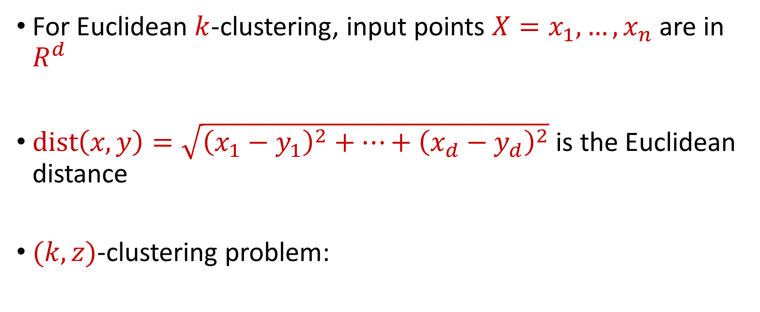


Euclidean $k$-Clustering
For Euclidean $k$-clustering, input points $X=x_{1},…,x_{n}$ are in $R^{d}$
$dist\left(x,y\right)=\sqrt{{\left(x_{1}−y_{1}\right)}^{2}+…+{\left(x_{d}−y_{d}\right)}^{2}}$ is the Euclidean distance
$(k,z)$-clustering problem:
$$\min_{C:\left|C\right|≤k} Cost\left(X,C\right)=\min_{C:\left|C\right|≤k}{Σ_{x∈X}\left(dist\left(x,C\right)\right)}^{z}$$

Slide 10
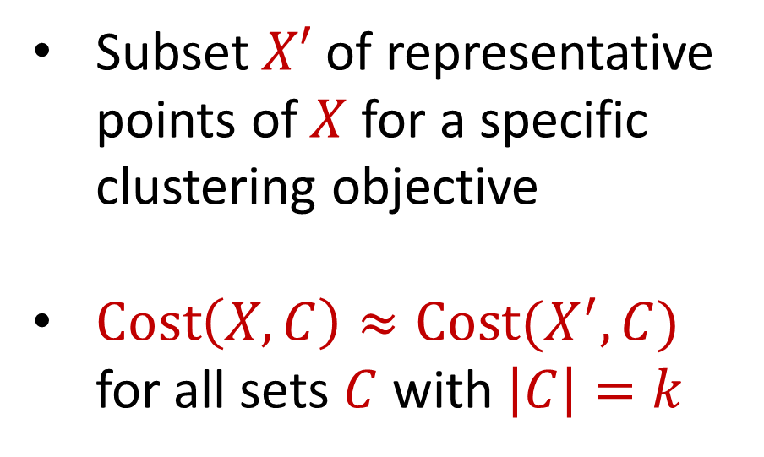
Coreset
Subset $X′$ of representative points of $X$ for a specific clustering objective
$Cost\left(X,C\right)≈Cost(X^{′},C)$ for all sets $C$ with $\left|C\right|=k$

Slide 11
Coreset
Subset $X′$ of representative points of $X$ for a specific clustering objective
$Cost\left(X,C\right)≈Cost(X^{′},C)$ for all sets $C$ with $\left|C\right|=k$

Slide 12
Coreset
Subset $X′$ of representative points of $X$ for a specific clustering objective
$Cost\left(X,C\right)≈Cost(X^{′},C)$ for all sets $C$ with $\left|C\right|=k$

Slide 13

Coreset (Formal Definition)
Given a set $X$ and an accuracy parameter $ε>0$, we say a set $X′$ with weight function $w$is an $(1+ε)$-multiplicative coreset for a cost function $Cost$, if for all queries $C$ with $\left|C\right|≤k$, we have
$$\left(1−ε\right)Cost(X,C)≤Cost(X′,C,w)≤\left(1+ε\right)Cost(X,C)$$
$(k,z)$-clustering: $Cost\left(X^{′},C,w\right)=\sum_{x∈X′}{{w\left(x\right)⋅\left(dist\left(x,C\right)\right)}^{z}}$

Slide 14
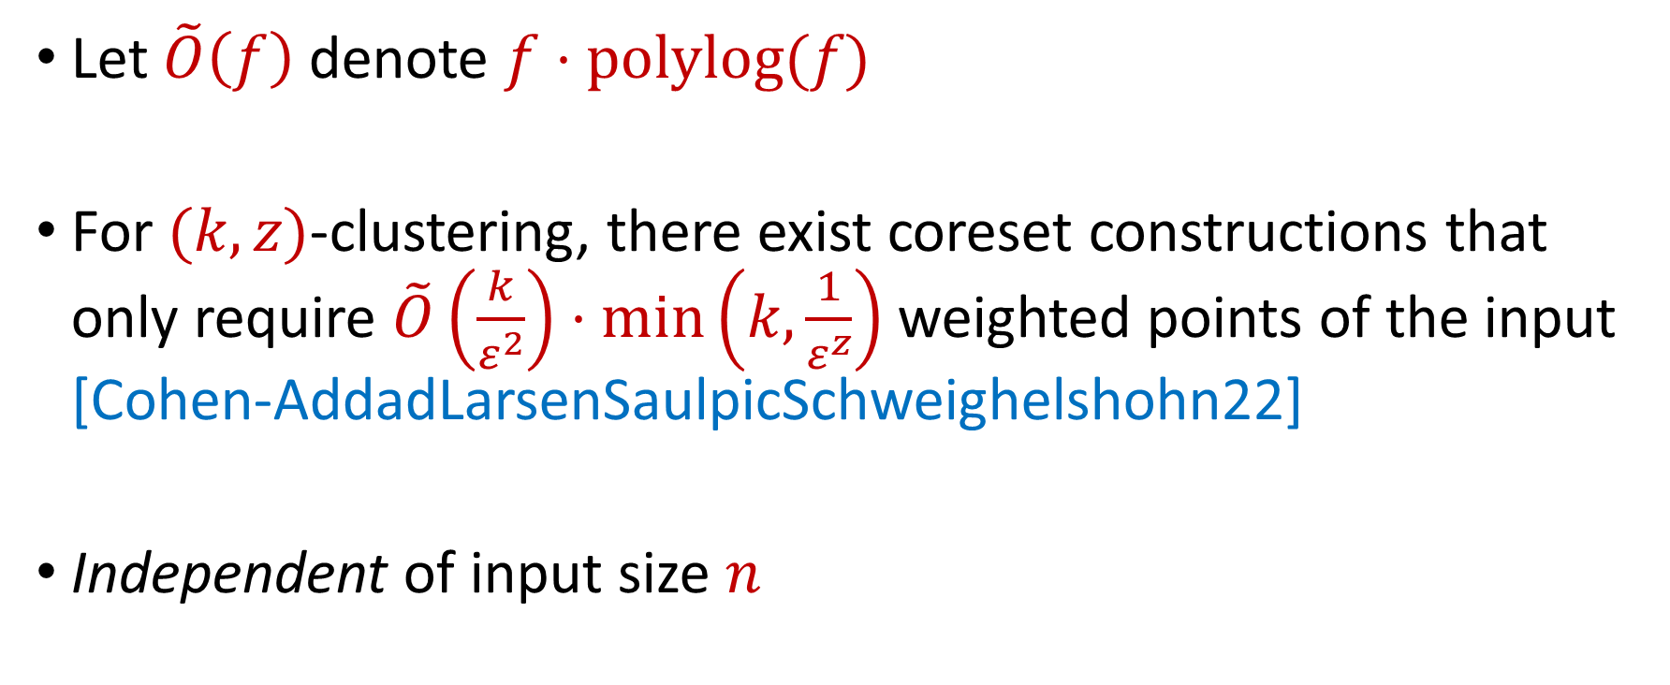
Coreset Constructions
Let $\tilde{O}\left(f\right)$ denote $f⋅polylog(f)$
For $(k,z)$-clustering, there exist coreset constructions that only require $\tilde{O}\left(\frac{k}{ε^{2}}\right)⋅\min\left(k,\frac{1}{ε^{z}}\right)$ weighted points of the input [Cohen-AddadLarsenSaulpicSchweighelshohn22]
Independent of input size $n$

Slide 15

The Streaming Model
Input: Updates to an underlying data set $X$ that arrive sequentially
Output: Evaluation (or approximation) of a given function
Goal: Use space sublinear in the size $n$of the input $X$

Slide 16
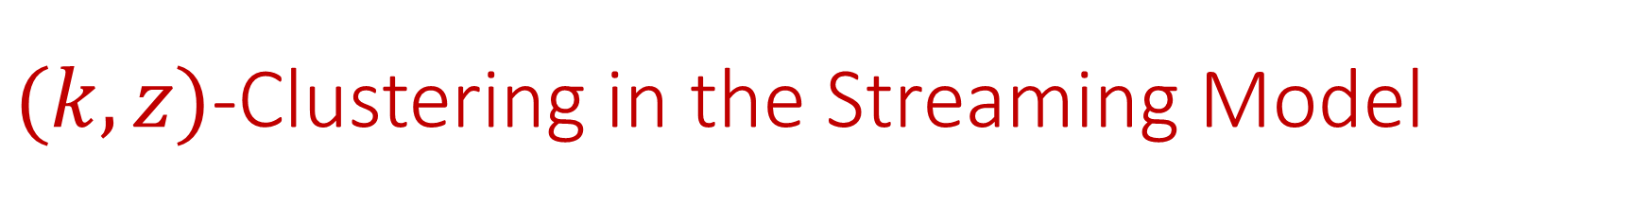
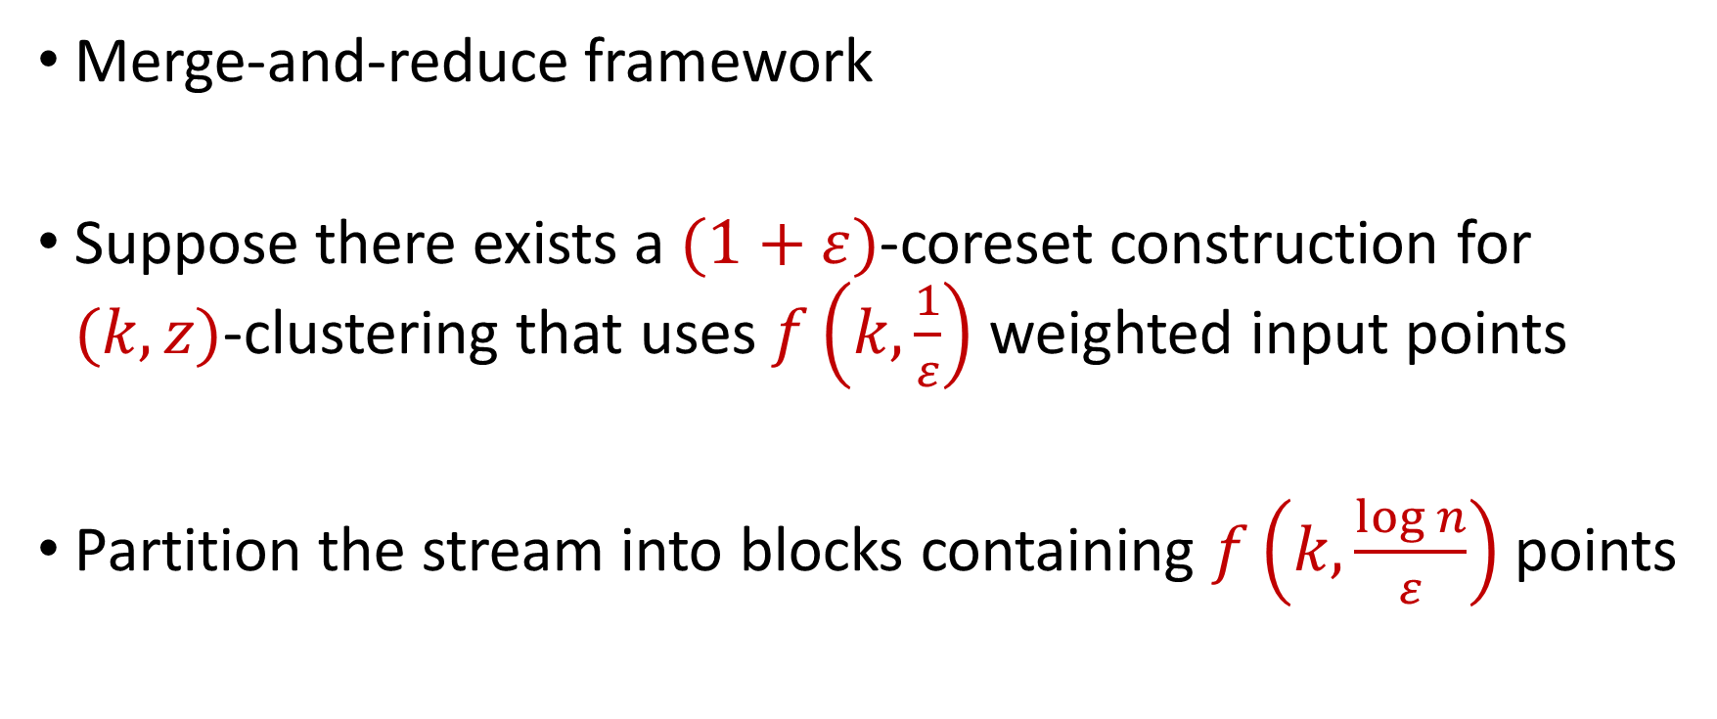
$(k,z)$-Clustering in the Streaming Model
Merge-and-reduce framework
Suppose there exists a $(1+ε)$-coreset construction for $(k,z)$-clustering that uses $f\left(k,\frac{1}{ε}\right)$ weighted input points
Partition the stream into blocks containing $f\left(k,\frac{\log{n}}{ε}\right)$ points

Slide 17
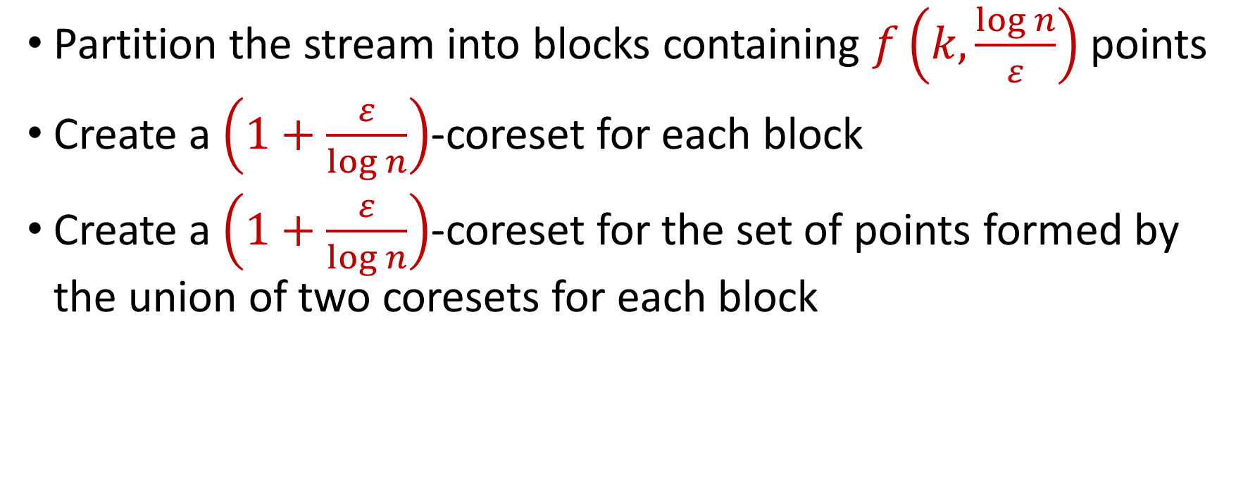
$(k,z)$-Clustering in the Streaming Model
Partition the stream into blocks containing $f\left(k,\frac{\log{n}}{ε}\right)$ points
Create a $\left(1+\frac{ε}{\log{n}}\right)$-coreset for each block
Create a $\left(1+\frac{ε}{\log{n}}\right)$-coreset for the set of points formed by the union of two coresets for each block
Reduce
Merge

Slide 18
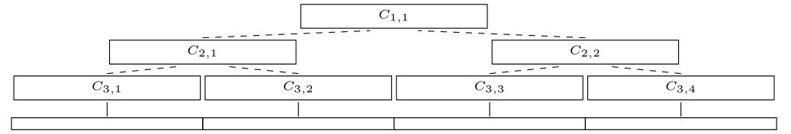
$(k,z)$-Clustering in the Streaming Model
Partition the stream into blocks containing $f\left(k,\frac{\log{n}}{ε}\right)$ points
Create a $\left(1+\frac{ε}{\log{n}}\right)$-coreset for each block
Create a $\left(1+\frac{ε}{\log{n}}\right)$-coreset for the set of points formed by the union of two coresets for each block

Slide 19
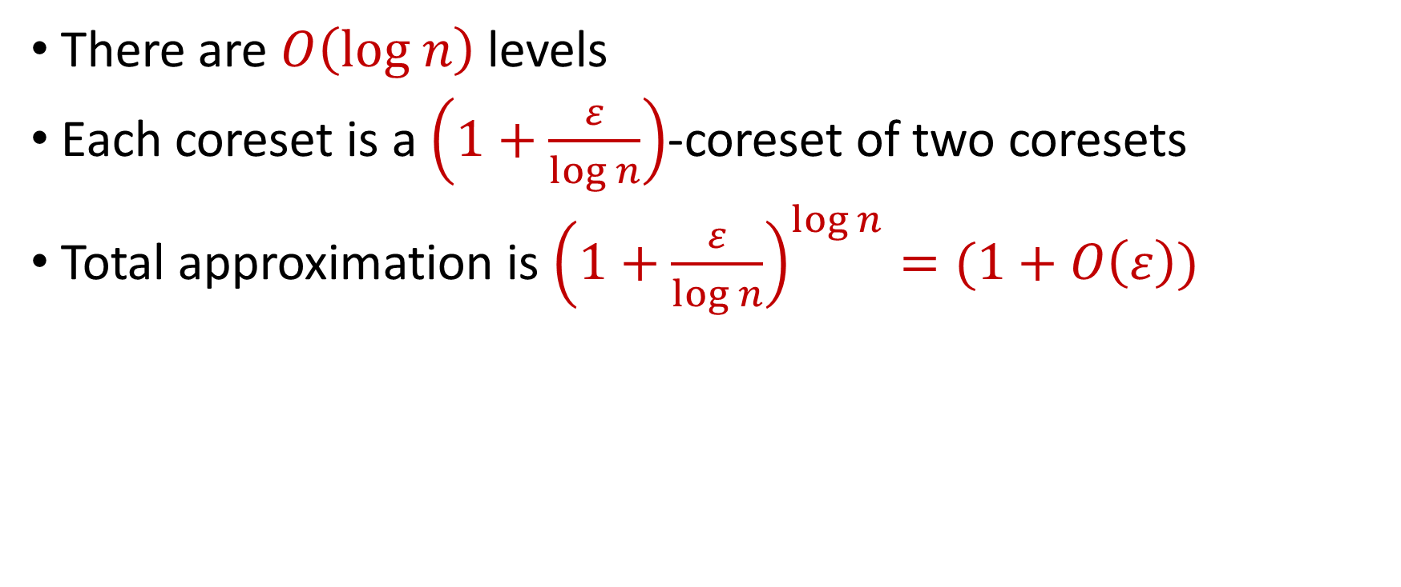
$(k,z)$-Clustering in the Streaming Model
There are $O\left(log n\right)$ levels
Each coreset is a $\left(1+\frac{ε}{\log{n}}\right)$-coreset of two coresets
Total approximation is ${\left(1+\frac{ε}{\log{n}}\right)}^{\log{n}}=(1+O\left(ε\right))$

Slide 20
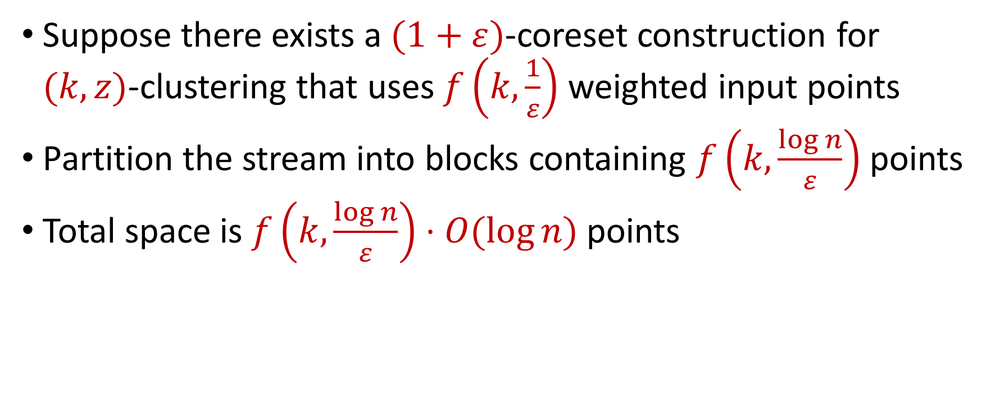
$(k,z)$-Clustering in the Streaming Model
Suppose there exists a $(1+ε)$-coreset construction for $(k,z)$-clustering that uses $f\left(k,\frac{1}{ε}\right)$ weighted input points
Partition the stream into blocks containing $f\left(k,\frac{\log{n}}{ε}\right)$ points
Total space is $f\left(k,\frac{\log{n}}{ε}\right)⋅O(log{n)}$ points

Slide 21
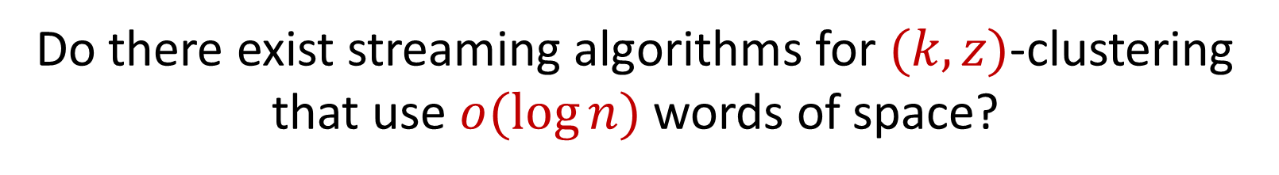
$(k,z)$-Clustering in the Streaming Model
Suppose there exists a $(1+ε)$-coreset construction for $(k,z)$-clustering that uses $f\left(k,\frac{1}{ε}\right)$ weighted input points
Partition the stream into blocks containing $f\left(k,\frac{\log{n}}{ε}\right)$ points
Total space is $f\left(k,\frac{\log{n}}{ε}\right)⋅O(log{n)}$ points
Do there exist streaming algorithms for $(k,z)$-clustering that use $o(\log{n)}$ words of space?

Slide 22
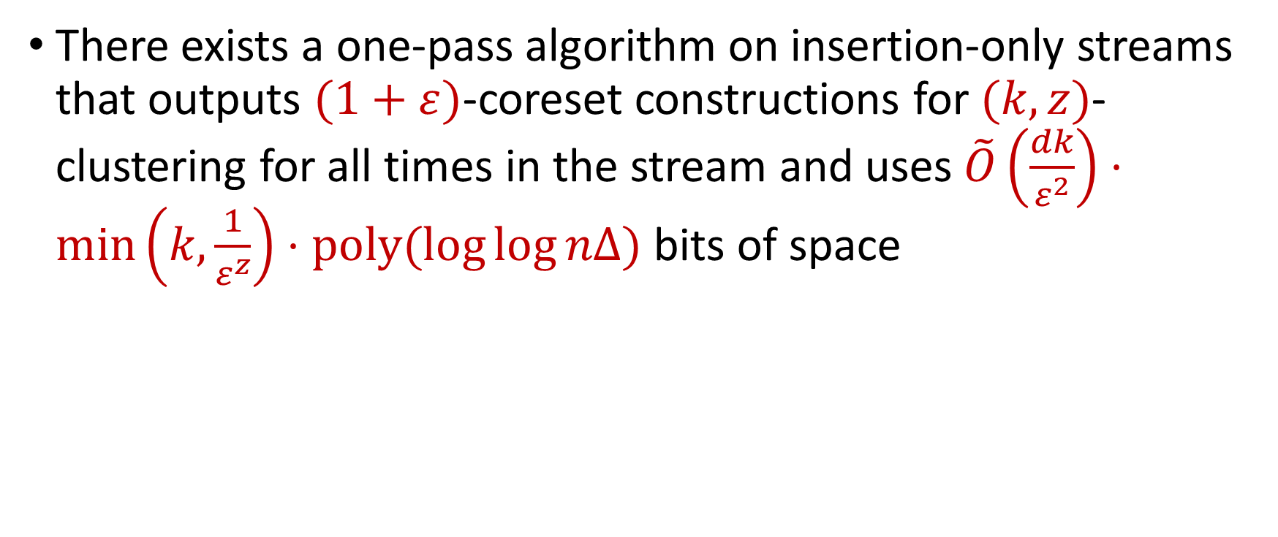
Our Results
There exists a one-pass algorithm on insertion-only streams that outputs $(1+ε)$-coreset constructions for $(k,z)$-clustering for all times in the stream and uses $\tilde{O}\left(\frac{dk}{ε^{2}}\right)⋅\min\left(k,\frac{1}{ε^{z}}\right)⋅poly(\log{\log{nΔ)}}$ bits of space

Slide 23
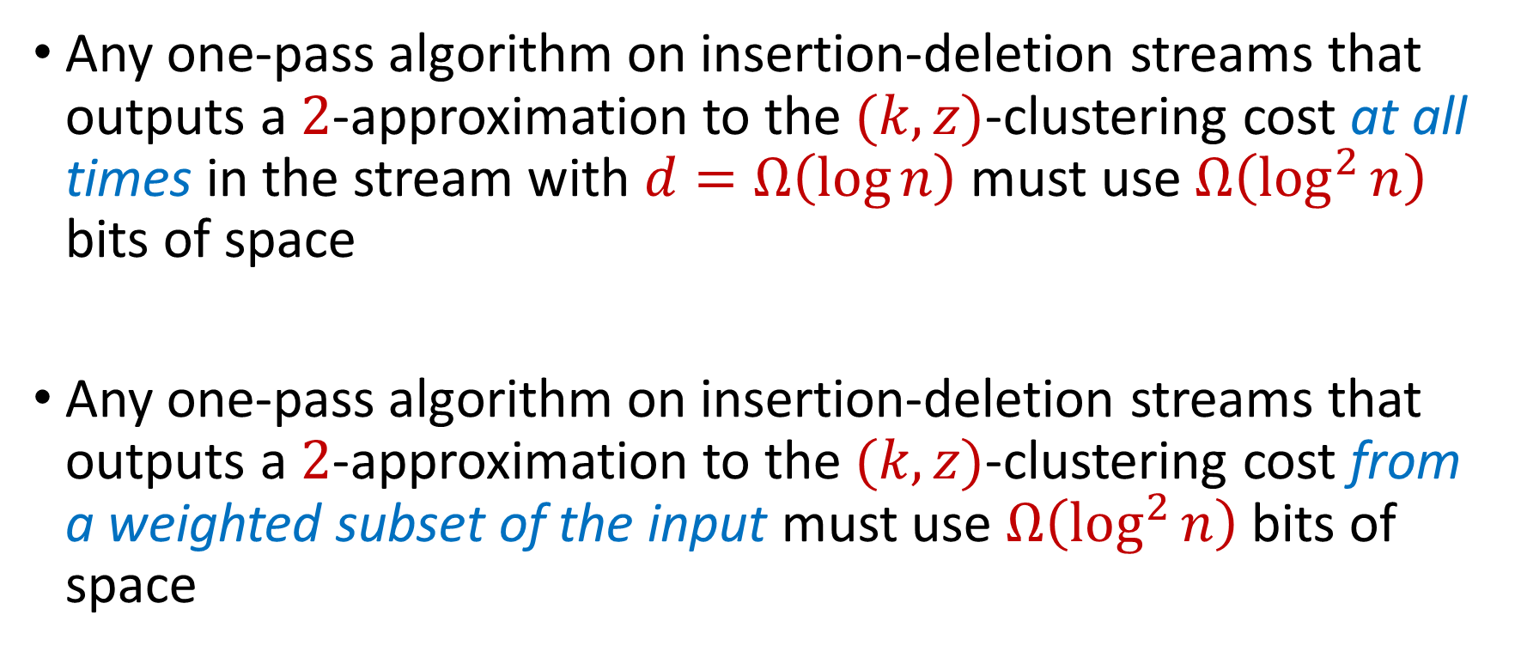
Our Results
Any one-pass algorithm on insertion-deletion streams that outputs a $2$-approximation to the $(k,z)$-clustering cost at all times in the stream with $d=Ω\left(\log{n}\right)$ must use $Ω\left(\log^{2}{n}\right)$ bits of space
Any one-pass algorithm on insertion-deletion streams that outputs a $2$-approximation to the $(k,z)$-clustering cost from a weighted subset of the input must use $Ω\left(\log^{2}{n}\right)$ bits of space

Slide 24
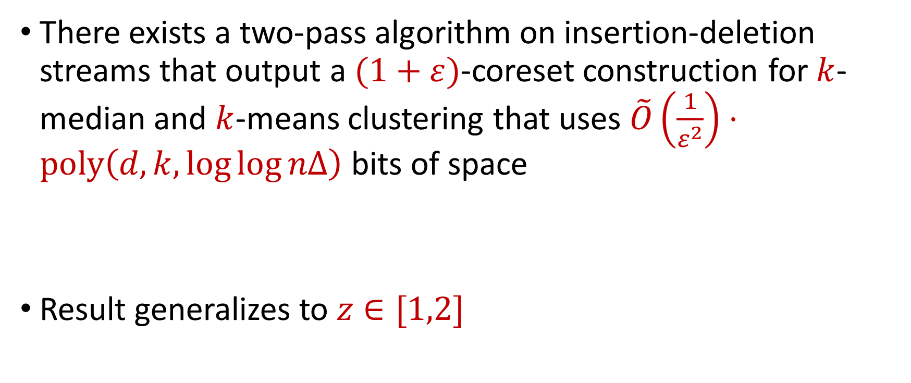
Our Results
There exists a two-pass algorithm on insertion-deletion streams that output a $(1+ε)$-coreset construction for $k$-median and $k$-means clustering that uses $\tilde{O}\left(\frac{1}{ε^{2}}\right)⋅poly\left(d,k,\log{\log{nΔ}}\right)$ bits of space
Result generalizes to $z∈[1,2]$

Slide 25

Our Results
Sum of the online sensitivities of a set of $n$ points in $R^{d}$ for $(k,z)$-clustering is at most $O\left(k\log^{2}{(ndΔ)}\right)$

Slide 26
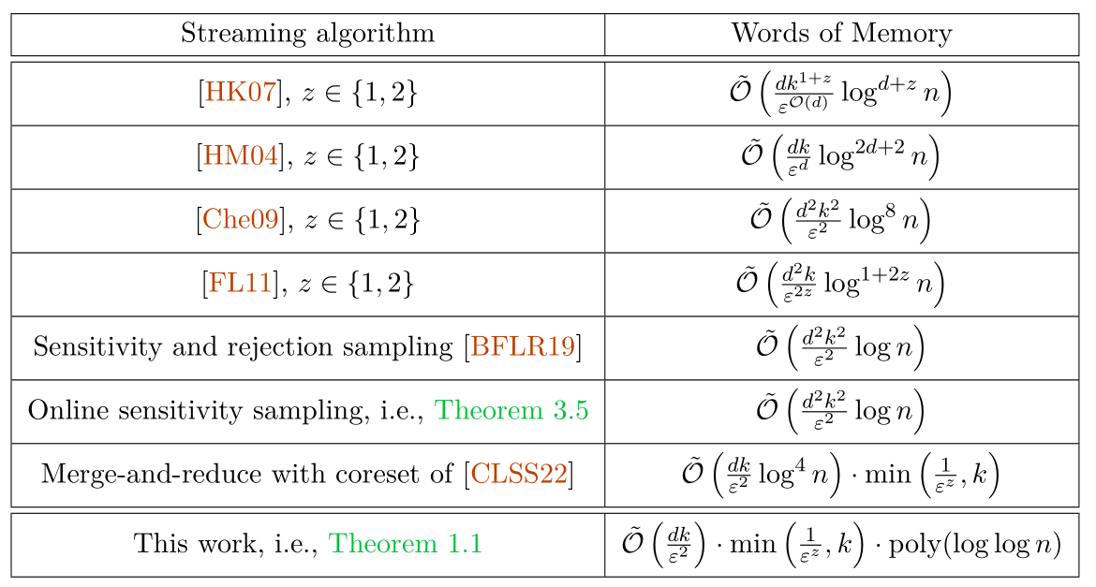

Slide 27

Coreset Construction and Sampling
Consider a fixed set $X$ and a fixed set $C$ of $k$ centers, which induces a fixed cost $Cost(X,C)$

Slide 28

Coreset Construction and Sampling
Consider a fixed set $X$ and a fixed set $C$ of $k$ centers, which induces a fixed cost $Cost(X,C)$
A simple way to obtain $X′$with $Cost\left(X^{′},C\right)≈Cost(X,C)$ is to uniformly sample points of $X$ into $X′$

Slide 29

Coreset Construction and Sampling
Consider a fixed set $X$ and a fixed set $C$ of $k$ centers, which induces a fixed cost $Cost(X,C)$
Uniform sampling needs a lot of samples of there is a single point that greatly contributes to $Cost(X,C)$

Slide 30

Coreset Construction and Sampling
Fix: Importance sampling, sample each point $x∈X$ into $X′$ with probability proportional $Cost(x,C)$, i.e., $Cost(x,C)/Cost(X,C)$

Slide 31
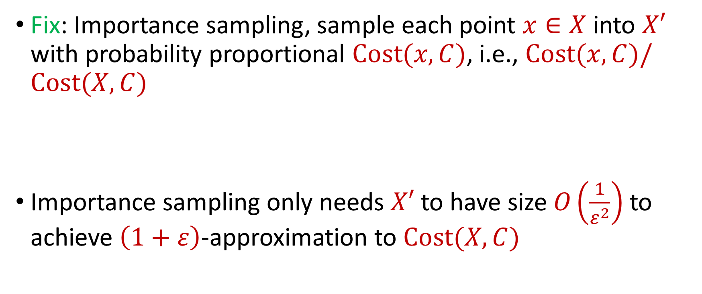
Coreset Construction and Sampling
Fix: Importance sampling, sample each point $x∈X$ into $X′$ with probability proportional $Cost(x,C)$, i.e., $Cost(x,C)/Cost(X,C)$
Importance sampling only needs $X′$ to have size $O\left(\frac{1}{ε^{2}}\right)$ to achieve $\left(1+ε\right)$-approximation to $Cost(X,C)$

Slide 32

Coreset Construction and Sampling
Importance sampling only needs $X′$ to have size $O\left(\frac{1}{ε^{2}}\right)$ to achieve $\left(1+ε\right)$-approximation to $Cost(X,C)$
To handle all possible sets of $k$ centers:

Slide 33
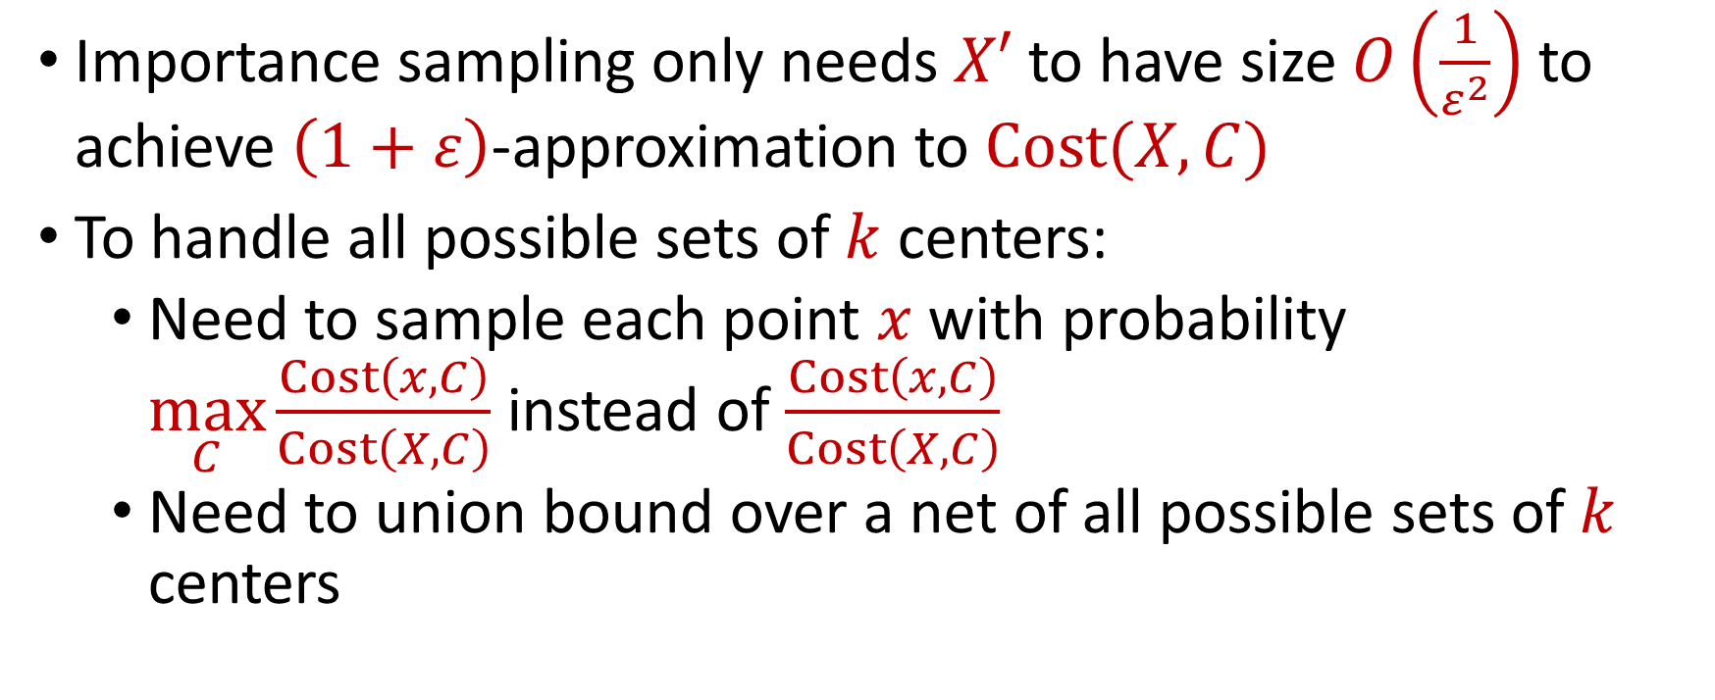
Coreset Construction and Sampling
Importance sampling only needs $X′$ to have size $O\left(\frac{1}{ε^{2}}\right)$ to achieve $\left(1+ε\right)$-approximation to $Cost(X,C)$
To handle all possible sets of $k$ centers:
Need to sample each point $x$ with probability $\max_{C}\frac{Cost\left(x,C\right)}{Cost\left(X,C\right)}$ instead of $\frac{Cost\left(x,C\right)}{Cost\left(X,C\right)}$
Need to union bound over a net of all possible sets of $k$ centers

Slide 34

Coreset Construction and Sampling
Importance sampling only needs $X′$ to have size $O\left(\frac{1}{ε^{2}}\right)$ to achieve $\left(1+ε\right)$-approximation to $Cost(X,C)$
To handle all possible sets of $k$ centers:
Need to sample each point $x$ with probability $\max_{C}\frac{Cost\left(x,C\right)}{Cost\left(X,C\right)}$ instead of $\frac{Cost\left(x,C\right)}{Cost\left(X,C\right)}$
Need to union bound over a net of all possible sets of $k$ centers
Net with size ${\left(\frac{nΔ}{ε}\right)}^{O(kd)}$

Slide 35
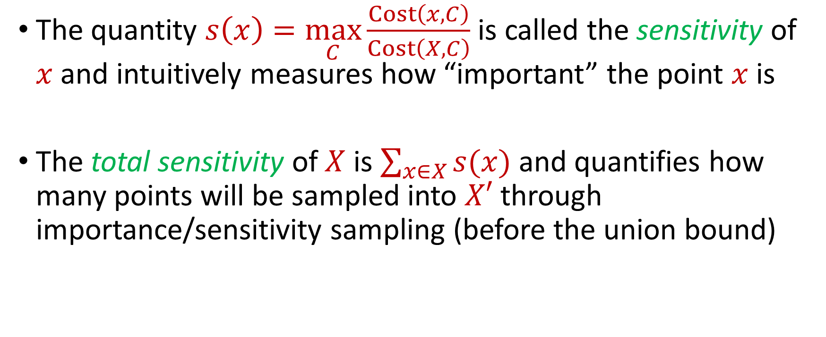
Sensitivity Sampling
The quantity $s\left(x\right)=\max_{C}\frac{Cost\left(x,C\right)}{Cost\left(X,C\right)}$ is called the sensitivity of $x$ and intuitively measures how “important” the point $x$ is
The total sensitivity of $X$ is $\sum_{x∈X}{s(x)}$ and quantifies how many points will be sampled into $X′$ through importance/sensitivity sampling (before the union bound)

Slide 36
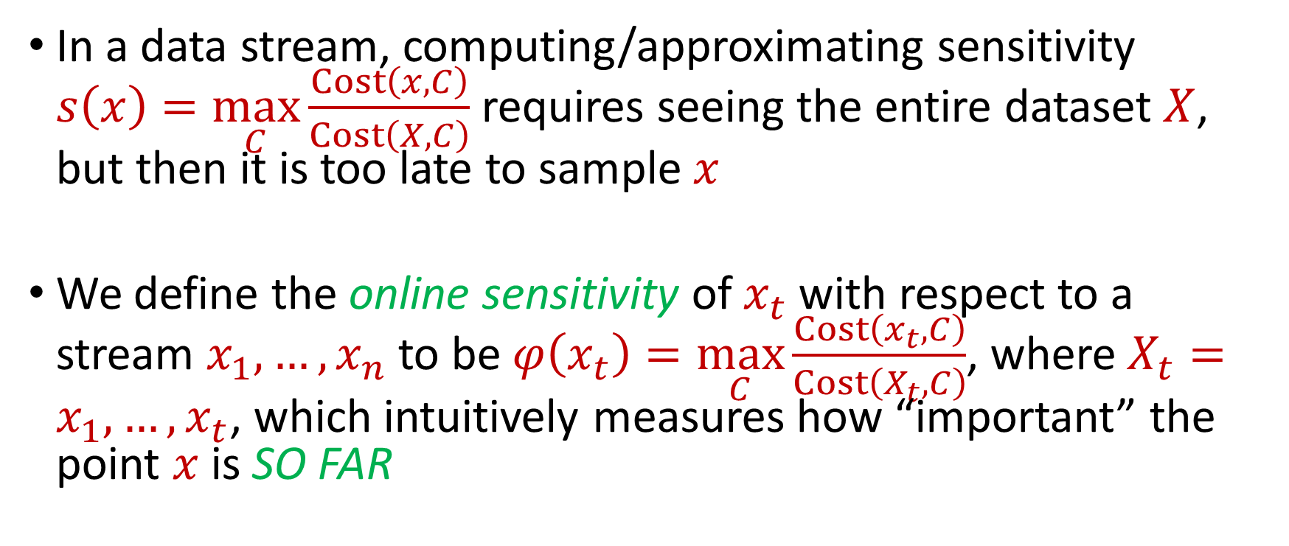
Online Sensitivity
In a data stream, computing/approximating sensitivity $s\left(x\right)=\max_{C}\frac{Cost\left(x,C\right)}{Cost\left(X,C\right)}$ requires seeing the entire dataset $X$, but then it is too late to sample $x$
We define the online sensitivity of $x_{t}$ with respect to a stream $x_{1},…,x_{n}$ to be $φ\left(x_{t}\right)=\max_{C}\frac{Cost\left(x_{t},C\right)}{Cost\left(X_{t},C\right)}$, where $X_{t}=x_{1},…,x_{t}$, which intuitively measures how “important” the point $x$ is SO FAR

Slide 37
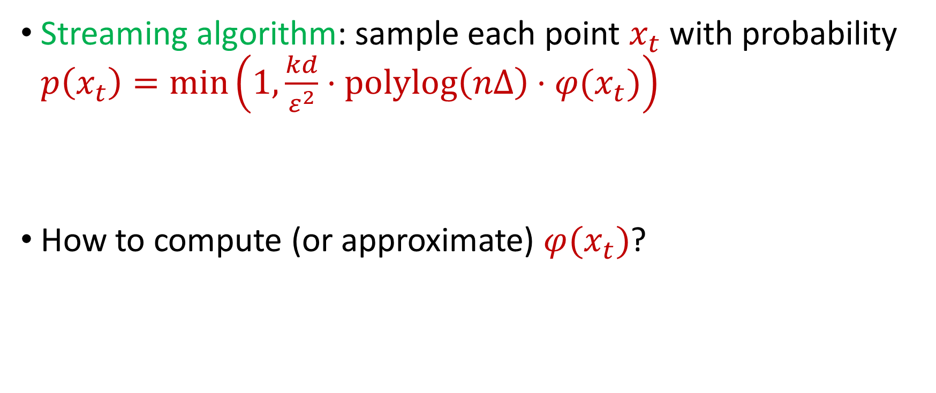
Online Sensitivity
Streaming algorithm: sample each point $x_{t}$ with probability $p\left(x_{t}\right)=\min\left(1,\frac{kd}{ε^{2}}⋅polylog\left(nΔ\right)⋅φ(x_{t})\right)$
How to compute (or approximate) $φ(x_{t})$?

Slide 38
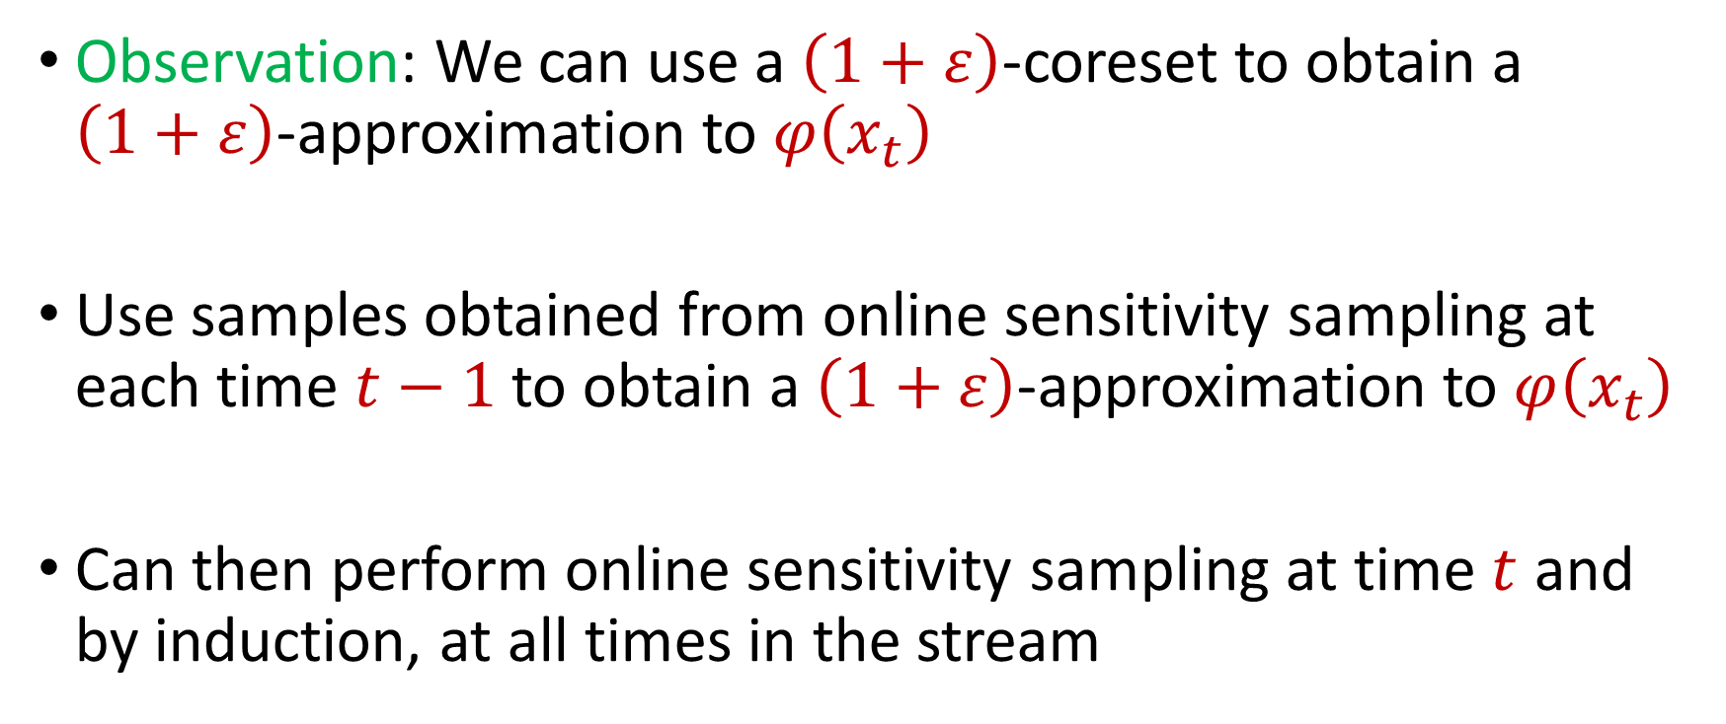
Online Sensitivity
Observation: We can use a $\left(1+ε\right)$-coreset to obtain a $\left(1+ε\right)$-approximation to $φ\left(x_{t}\right)$
Use samples obtained from online sensitivity sampling at each time $t−1$ to obtain a $\left(1+ε\right)$-approximation to $φ\left(x_{t}\right)$
Can then perform online sensitivity sampling at time $t$ and by induction, at all times in the stream

Slide 39
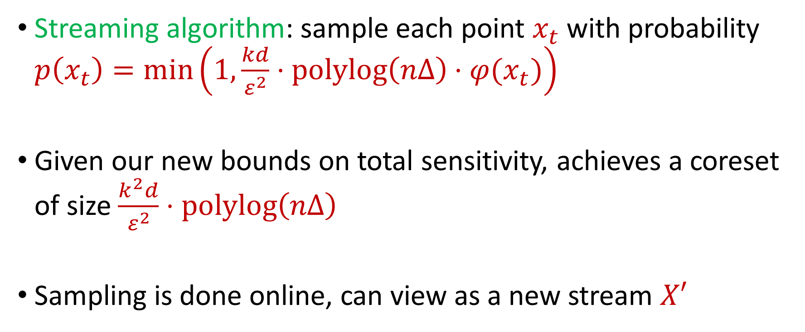
Online Sensitivity
Streaming algorithm: sample each point $x_{t}$ with probability $p\left(x_{t}\right)=\min\left(1,\frac{kd}{ε^{2}}⋅polylog\left(nΔ\right)⋅φ(x_{t})\right)$
Given our new bounds on total sensitivity, achieves a coreset of size $\frac{k^{2}d}{ε^{2}}⋅polylog\left(nΔ\right)$
Sampling is done online, can view as a new stream $X′$

Slide 40
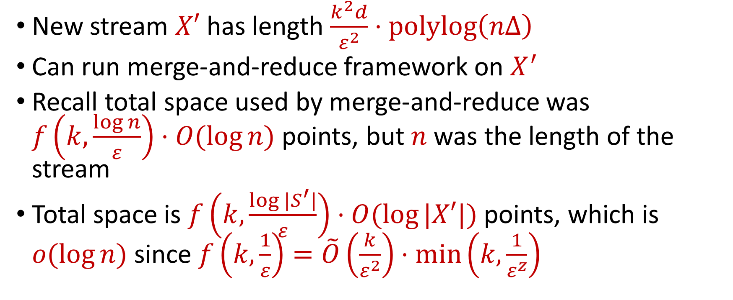
Online Sensitivity
New stream $X′$ has length $\frac{k^{2}d}{ε^{2}}⋅polylog\left(nΔ\right)$
Can run merge-and-reduce framework on $X^{′}$
Recall total space used by merge-and-reduce was $f\left(k,\frac{\log{n}}{ε}\right)⋅O(log{n)}$ points, but $n$ was the length of the stream
Total space is $f\left(k,\frac{\log{|S^{′}|}}{ε}\right)⋅O(log{|X′|)}$ points, which is $o(\log{n)}$ since $f\left(k,\frac{1}{ε}\right)=\tilde{O}\left(\frac{k}{ε^{2}}\right)⋅\min\left(k,\frac{1}{ε^{z}}\right)$

Slide 41

Insertion-Deletion Streams
Use first pass to estimate sensitivity of each point $n$ in the stream
Use second pass to perform sensitivity sampling

Slide 42
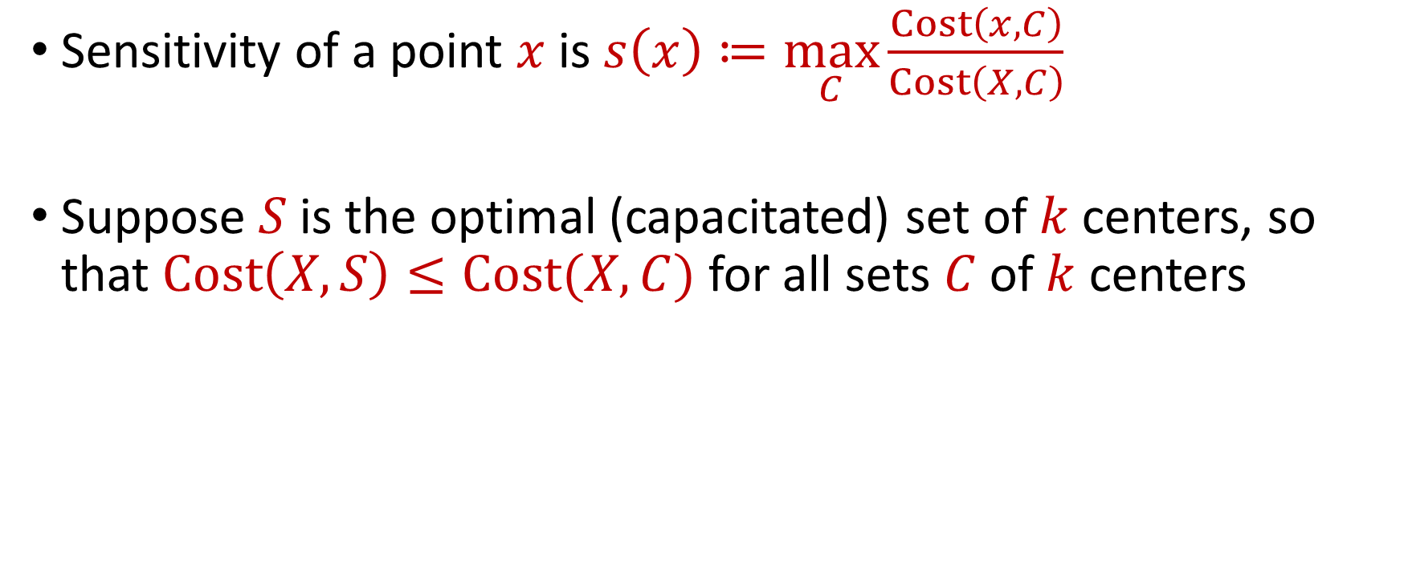
Sensitivity Estimation
Sensitivity of a point $x$is $s\left(x\right)≔\max_{C}\frac{Cost\left(x,C\right)}{Cost\left(X,C\right)}$
Suppose $S$is the optimal (capacitated) set of $k$centers, so that $Cost\left(X,S\right)≤Cost(X,C)$ for all sets $C$of $k$ centers

Slide 43


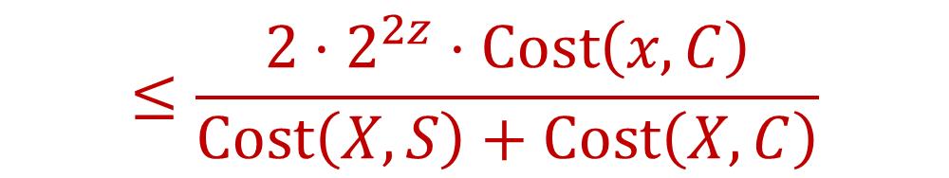
Sensitivity Estimation
$$\frac{Cost\left(x,C\right)}{Cost\left(X,C\right)}≤\frac{2^{z}⋅Cost\left(x,C\right)}{Cost\left(X,S\right)+Cost\left(C,S\right)}$$
$$≤\frac{{2⋅2}^{2z}⋅Cost\left(x,C\right)}{Cost\left(X,S\right)+Cost\left(X,C\right)}$$
$$≤\frac{2^{O(z)}⋅Cost\left(x,C\right)}{Cost\left(X,C\right)}$$

Slide 44
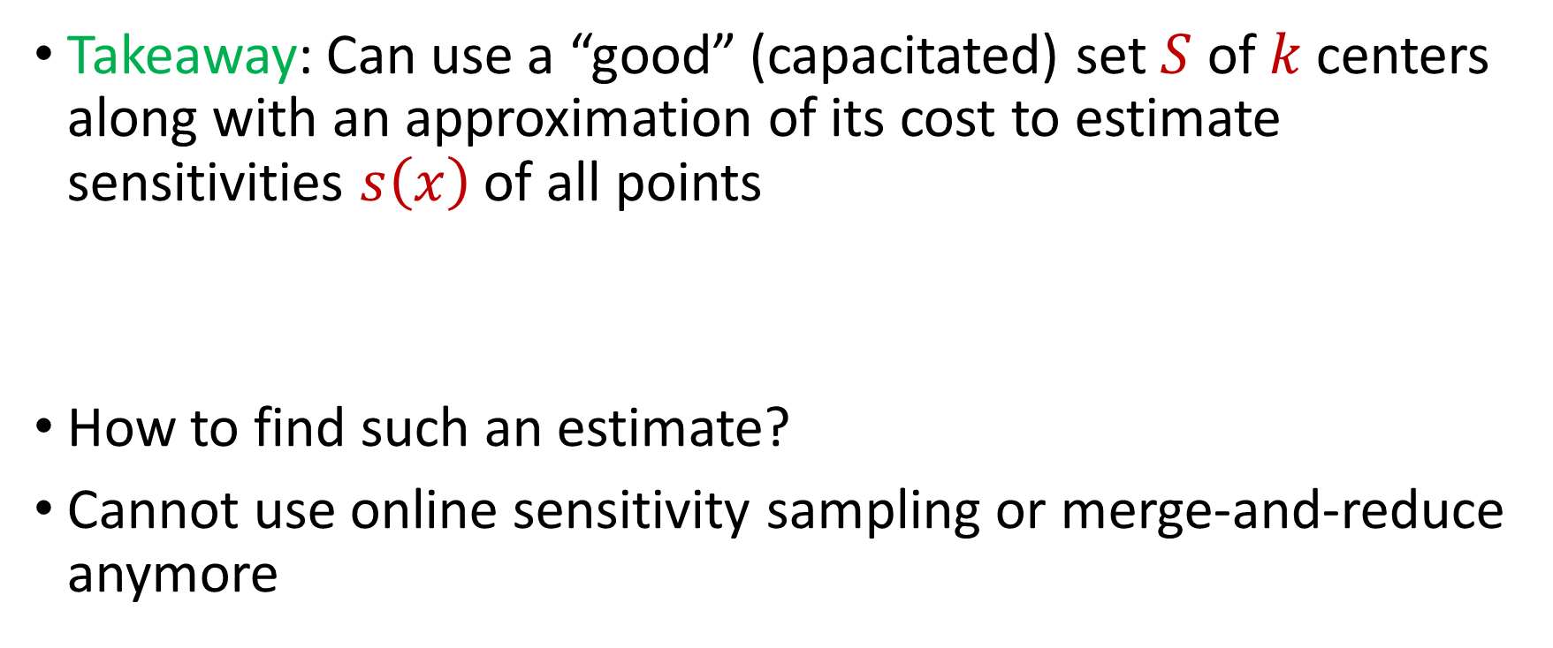
Sensitivity Estimation
Takeaway: Can use a “good” (capacitated) set $S$ of $k$centers along with an approximation of its cost to estimate sensitivities $s\left(x\right)$ of all points
How to find such an estimate?
Cannot use online sensitivity sampling or merge-and-reduce anymore

Slide 45
Quadtree Embedding

Slide 46

Quadtree Embedding
$$Δ$$

Slide 47
Quadtree Embedding
$$Δ$$

Slide 48
Quadtree Embedding
$$Δ$$

Slide 49
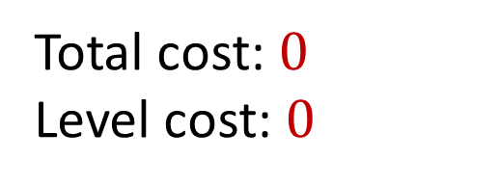
Quadtree Embedding
Total cost: $0$
Level cost: $0$
7
$$Δ$$
6
6

Slide 50

Quadtree Embedding
Total cost: $\frac{Δ}{2}⋅7$
Level cost: $\frac{Δ}{2}⋅7$
7
$$Δ$$
6
6

Slide 51
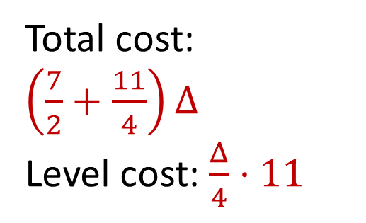
Quadtree Embedding
Total cost: $\left(\frac{7}{2}+\frac{11}{4}\right)Δ$
Level cost: $\frac{Δ}{4}⋅11$
7
$$Δ$$
6
6

Slide 52
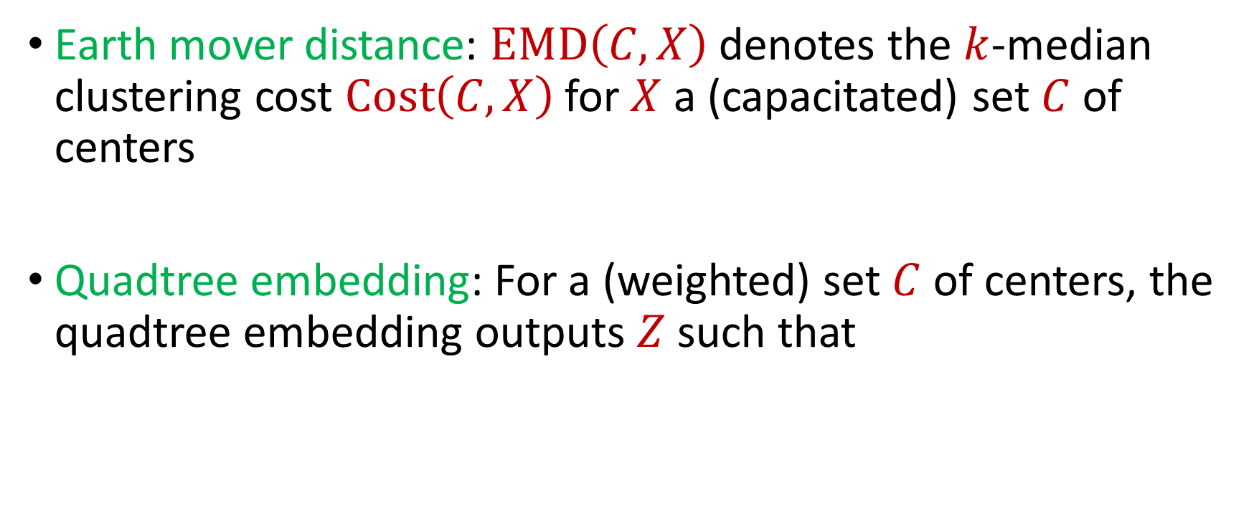
Quadtree Embedding
Earth mover distance: $EMD\left(C,X\right)$ denotes the $k$-median clustering cost $Cost\left(C,X\right)$for $X$ a (capacitated) set $C$ of centers
Quadtree embedding: For a (weighted) set $C$ of centers, the quadtree embedding outputs $Z$ such that
$$EMD\left(C,X\right)≤O\left(\sqrt{d}\right)⋅Z≤⋅O\left(d^{1.5}\right)(\log{k+\log{\log{Δ)}}}EMD(C,X)$$

Slide 53
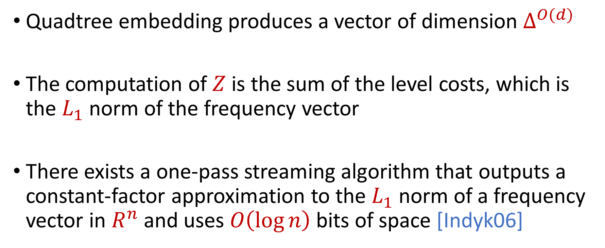
Quadtree Embedding
Quadtree embedding produces a vector of dimension $Δ^{O(d)}$
The computation of $Z$ is the sum of the level costs, which is the $L_{1}$ norm of the frequency vector
There exists a one-pass streaming algorithm that outputs a constant-factor approximation to the $L_{1}$ norm of a frequency vector in $R^{n}$ and uses $O\left(\log{n}\right)$ bits of space [Indyk06]

Slide 54

EMD Sketch
EMD sketch: There exists a one-pass streaming algorithm that uses $O\left(d\log{Δ}\right)$ bits of space and outputs $Z$ such that
$$EMD\left(C,X\right)≤O\left(\sqrt{d}\right)⋅Z≤⋅O\left(d^{1.5}\right)(\log{k+\log{\log{Δ)}}}EMD(C,X)$$

Slide 55
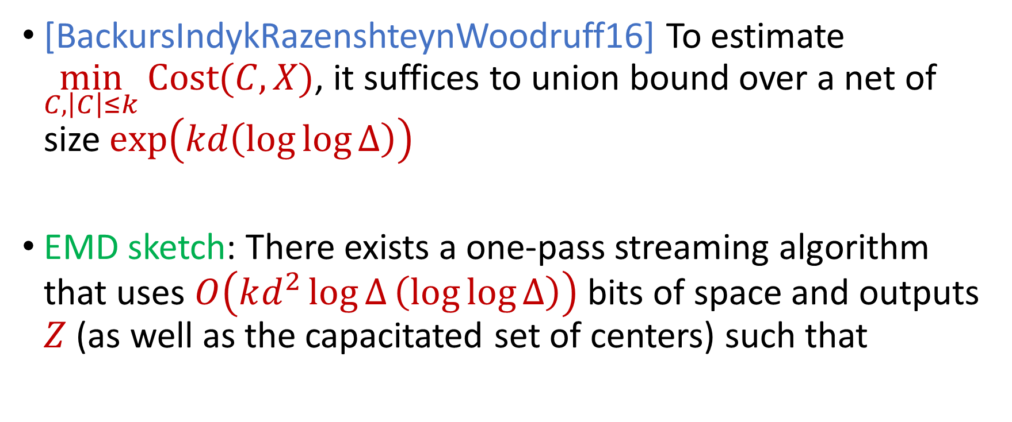
EMD Sketch
[BackursIndykRazenshteynWoodruff16] To estimate $\min_{C, \left|C\right|≤k} Cost(C,X)$, it suffices to union bound over a net of size $exp\left(kd\left(\log{\log{Δ}}\right)\right)$
EMD sketch: There exists a one-pass streaming algorithm that uses $O\left(kd^{2}\log{Δ}\left(\log{\log{Δ}}\right)\right)$ bits of space and outputs $Z$ (as well as the capacitated set of centers) such that
$$OPT≤O\left(\sqrt{d}\right)⋅Z≤⋅O\left(d^{1.5}\right)(\log{k+\log{\log{Δ)}}}OPT$$

Slide 56
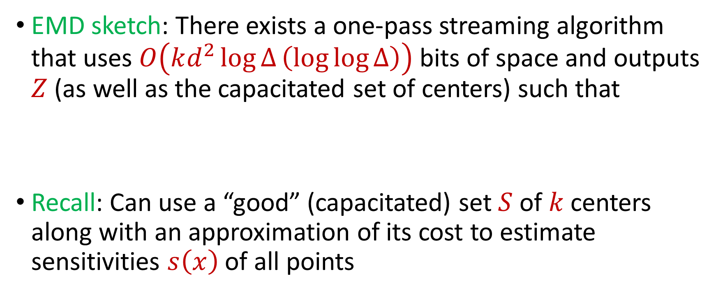
Summary
EMD sketch: There exists a one-pass streaming algorithm that uses $O\left(kd^{2}\log{Δ}\left(\log{\log{Δ}}\right)\right)$ bits of space and outputs $Z$ (as well as the capacitated set of centers) such that
Recall: Can use a “good” (capacitated) set $S$ of $k$centers along with an approximation of its cost to estimate sensitivities $s\left(x\right)$ of all points
$$OPT≤O\left(\sqrt{d}\right)⋅Z≤⋅O\left(d^{1.5}\right)(\log{k+\log{\log{Δ)}}}OPT$$

Slide 57

First Pass to Second Pass
We can set up the EMD sketch in the first pass of the stream
At the end of the first pass of the stream, we have a data structure that can estimate the sensitivity $s\left(x\right)$ for any query $x∈{\left[Δ\right]}^{d}$
In the second pass of the stream, we would like to perform sensitivity sampling

Slide 58

Sensitivity Sampling
DO NOT: Sample each point $x$ in the stream with probability proportional to $s\left(x\right)$
Does not work for insertion-deletion streams
DO: Sample each point $x$ in the universe ${\left[Δ\right]}^{d}$ into a substream $U′$ with probability proportional to $s(x)$
$U′$can have a large number of points
$U′$can have a small number of points at the end of the stream

Slide 59

Sensitivity Sampling
Sample each point $x$ in the universe ${\left[Δ\right]}^{d}$ into a substream $U′$ with probability proportional to $s(x)$
$U′$will have $poly\left(k,d,\frac{1}{ε^{2}}\right)$ points at the end of the stream
Use sparse recovery on $U′$

Slide 60

Sparse Recovery
Given a stream$U′$ that induces a frequency vector of length $n$ with $s$ nonzero entries, there exists an algorithm that uses $O\left(s\log{n}\right)$ bits of space and recovers the nonzero coordinates and their frequencies
Since elements are sampled into $U′$ by their sensitivities, recovering $U′$by sparse recovery corresponds to sensitivity sampling!

Slide 61


$k$-Median Framework
First pass: set up the EMD sketch
Second pass:
Sample elements into a substream $U′$ with probability proportional to their sensitivities
Run sparse recovery on $U′$

Slide 62

Quadtree Embedding
Level cost: $\frac{Δ}{4}⋅11$
7
$$Δ$$
6
6

Slide 63

Quadtree Embedding
Level cost: $\frac{Δ^{2}}{16}⋅11$
7
$$Δ$$
6
6

Slide 64

Quadtree Embedding
If $x$ and $c$ have distance $αΔ$, the probability it will be split by a grid of length $\frac{Δ}{2^{i}}$ is roughly $\frac{2^{i}}{α}$
Expected cost for $k$-median is $αΔ$
Expected cost of $k$-means is $\frac{Δ^{2}}{2^{i}α}$, i.e., distortion $2^{i}α^{3}$
Recall: worse EMD sketch guarantee corresponds to larger oversampling necessary for sensitivity sampling

Slide 65
Quadtree Embedding
Intuition: Bad distortion results when pairs of points are “too close” to the boundary of the hypergrid
Goal: Prevent this case from happening
Fix: When a query center is too close to the boundary of the hypergrid, create another center on the opposite cell!

Slide 66
Quadtree Embedding
7
$$Δ$$
6
6

Slide 67
Quadtree Embedding
7
$$Δ$$
6
6

Slide 68
Quadtree Embedding
7
$$Δ$$
6
6

Slide 69
Quadtree Embedding
7
$$Δ$$
6
6

Slide 70
Quadtree Embedding
7
$$Δ$$
6
6

Slide 71

Wasserstein Sketch
Wasserstein-$z$ distance: $WASSD\left(C,X\right)$ denotes the $(k,z)$-clustering cost $Cost\left(C,X\right)$for $X$ a (capacitated) set $C$ of centers
Wasserstein sketch: There exists a one-pass streaming algorithm that uses $O\left(d\log{Δ}\right)$ bits of space and outputs $Z$ such that
$$Z≤⋅O\left(d^{1+0.5z}\log^{z−1}{Δ}\right)⋅WASSD(C,X)$$

Slide 72


Applying $k$-Median Framework to $k$-Means
First pass: set up the Wasserstein sketch
Second pass:
Sample elements into a substream $U′$ with probability proportional to their sensitivities
Run sparse recovery on $U′$

Slide 73

Applying $k$-Median Framework to $k$-Means
Problem: Because the distortion of the Wasserstein embedding is $O\left(d^{1+0.5z}\log^{z−1}{Δ}\right)$, we need to sample $O\left(d^{1.5}\log{Δ}\right)$ points
For $k$-median, we stored all the points, using $O\left(d\log{Δ}\right)$ bits of space per point
Cannot afford to store all points explicitly here

Slide 74

Applying $k$-Median Framework to $k$-Means
Cannot afford to store all points explicitly here
Instead, store offset of each point from one of the centers of near-optimal solution $S$

